Slide 1


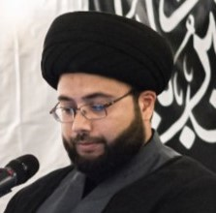
وَنُرِيدُ أَن نَّمُنَّ عَلَى الَّذِينَ اسْتُضْعِفُوا فِي الْأَرْضِ وَنَجْعَلَهُمْ أَئِمَّةً وَنَجْعَلَهُمُ الْوَارِثِينَ
﴿القصص : 5﴾‏
بِسْمِ اللَّهِ الرَّحْمَٰنِ الرَّحِيمِ
“And We desired to show favor to those who were abased in the land, and to make them imams, and to make them the heirs”
عشرة محرم الحرام
1446 AH
Visiting Scholar
Sayed Kamil Kazmi
An educator and a religious scholar with a diverse cultural and professional background
Sunday, July 7 to Thursday, July 18, 2024
Full night program on the eve of Ashur
Start Time: 7:00pm
Location: 204 Madison Ave S, Kitchener, ON, N2G 3M8
Daily Programs
Quran, Salam & Marsiyah, Speech, Noha, Ziyarat Ashura, Salah
Live broadcast: www.tinyurl.com/azsa-youtube/live
Sponsor Programs and Al Zahra Building
Al Zahra has the permission to spend khums for building
Tax receipts are provided for all monetary donations
Visit alzahra.ca/donate
e-transfer to finance@alzahra.ca
www.alzahra.ca | Al-Zahra Shia Association – Waterloo Region | program@alzahra.ca

